Slide 1
S2-19_DSECLZC415 MULTI MEDIA MINING SESSION 15
AUGUST 29 2020 – Dr.D.VENKATA SUBRAMANIAN
Slide Courtesy: Prof. T.V. Rao

Slide 2

Mining Text Data: An Introduction
Data Mining / Knowledge Discovery
Structured Data Multimedia Free Text Hypertext
HomeLoan (
Loanee: Frank Rizzo
Lender: MWF
Agency: Lake View
Amount: $200,000
Term: 15 years
)
Frank Rizzo bought
his home from Lake
View Real Estate in
1992.
He paid $200,000
under a15-year loan
from MW Financial.
<a href>Frank Rizzo
</a> Bought
<a hef>this home</a>
from <a href>Lake
View Real Estate</a>
In <b>1992</b>.
<p>...
Loans($200K,[map],...)
Notes:
Throughout this course we have been discussing Data Mining over a variety of data types.
Two former types we covered were Structured Data (relational) and multimedia data.
Today and in the last class we have been discussing Data Mining over free text,
and our next section will cover hypertext, such as web pages.
Text mining is well motivated, due to the fact that much of the world’s data can be
found in free text form (newspaper articles, emails, literature, etc.). There is a
lot of information available to mine.
While mining free text has the same goals as data mining in general
(extracting useful knowledge/stats/trends), text mining must overcome
a major difficulty – there is no explicit structure.
Machines can reason will relational data well since schemas are explicitly available.
Free text, however, encodes all semantic information within natural language. Our
text mining algorithms, then, must make some sense out of this natural language
representation. Humans are great at doing this, but this has proved to be a problem for machines.

Slide 3
QUICK RECAP OF WHAT WAS COVERED IN TEXT MINING/last class
BASICS OF TEXT MINING
NATURAL LANGUAGE PROCESSING(NLP)
WORD CLOUD
LEMMATIZATION , STEMMING
BAG OF WORDS
TF, IDF AND TF-IDF
COSINE SIMILARITY
PARSE TREE
MEASURES OF TEXT – PRECISION AND RECALL
INFORMATION RETRIEVAL(IR)

Slide 4
Information Retrieval Techniques
Index Terms (Attribute) Selection:
Stop list
Word stem
Index terms weighting methods
Terms  Documents Frequency Matrices
Information Retrieval Models:
Boolean Model (simplistic)
Vector Space Model (Document Ranking considered)
Etc.

Slide 5
Boolean Model
Consider that index terms are either present or absent in a document
As a result, the index term weights are assumed to be all binaries
A query is composed of index terms linked by three connectives: not, and, and or
e.g.: car and repair, plane or airplane
The Boolean model predicts that each document is either relevant or non-relevant based on the match of a document to the query

Slide 6
Keyword-Based Retrieval
A document is represented by a string, which can be identified by a set of keywords
Queries may use expressions of keywords
E.g., car and repair shop, tea or coffee, DBMS but not Oracle
Queries and retrieval should consider synonyms, e.g., repair and maintenance
Major difficulties of the model
Synonymy: A keyword T does not appear anywhere in the document, even though the document is closely related to T, e.g., data mining
Polysemy: The same keyword may mean different things in different contexts, e.g., mining

Slide 7
Similarity-Based Retrieval in Text Data
Finds similar documents based on a set of common keywords
Answer should be based on the degree of relevance based on the nearness of the keywords, relative frequency of the keywords, etc.
Basic techniques
Stop list
Set of words that are deemed “irrelevant”, even though they may appear frequently
E.g., a, the, of, for, to, with, etc.
Stop lists may vary when document set varies

Slide 8
Similarity-Based Retrieval in Text Data
Word stem
Several words are small syntactic variants of each other since they share a common word stem
E.g., drug, drugs, drugged
A term frequency table
Each entry frequent_table(i, j) = # of occurrences of the word t_{i} in document d_{i}
Usually, the ratio instead of the absolute number of occurrences is used
Similarity metrics: measure the closeness of a document to a query (a set of keywords)
Relative term occurrences
Cosine distance:

Slide 9
Vector Space Model
Represent a doc by a term vector
Term: basic concept, e.g., word or phrase
Each term defines one dimension
N terms define a N-dimensional space
Element of vector corresponds to term weight
E.g., d = (x₁,…,x_{N}), x_{i} is “importance” of term i
New document is assigned to the most likely category based on vector similarity.

Slide 10
What VS Model Does Not Specify
How to select terms to capture “basic concepts”
Word stopping
e.g. “a”, “the”, “always”, “along”
Word stemming
e.g. “computer”, “computing”, “computerize” => “compute”
Latent semantic indexing
How to assign weights
Not all words are equally important: Some are more indicative than others
e.g. “algebra” vs. “science”
How to measure the similarity

Slide 11
How to Assign Weights
Two-fold heuristics based on frequency
TF (Term frequency)
More frequent within a document → more relevant to semantics
IDF (Inverse document frequency)
Less frequent among documents → more discriminative

Slide 12

TF Weighting
Weighting:
More frequent => more relevant to topic
Raw TF= f(t,d): how many times term t appears in doc d
Normalization:
Document length varies => relative frequency preferred
e.g., Maximum frequency normalization

Slide 13

IDF Weighting
Ideas:
Less frequent among documents → more discriminative
Formula:
n — total number of docs
k — # docs with term t appearing
(the DF document frequency)

Slide 14
TF-IDF Weighting
TF-IDF weighting : weight(t, d) = TF(t, d) * IDF(t)
Freqent within doc → high tf → high weight
Selective among docs → high idf → high weight
Recall VS model
Each selected term represents one dimension
Each doc is represented by a feature vector
Its t-term coordinate of document d is the TF-IDF weight
This is more reasonable
Just for illustration …
Many complex and more effective weighting variants exist in practice

Slide 15
VS Model-Based Classifiers
What do we have so far?
A feature space with similarity measure
This is a classic supervised learning problem
Search for an approximation to classification hyper plane
VS model based classifiers
K-NN
Decision tree based
Neural networks
Support vector machine

Slide 16
Probabilistic Retrieval Models
The ranking function based on the probability that a given document d is relevant to a query q,
or p(R = 1| d, q) where R ∈ {0, 1} is a binary random variable denoting relevance.
In query likelihood retrieval model (one of the probabilistic models), we assume that this probability of relevance can be approximated by the probability of a query given a document and relevance,
p(q | d, R = 1).
Intuitively, if a user likes document d, how likely would the user enter query q in order to retrieve document d?

Slide 17
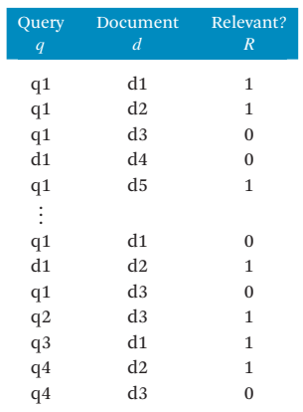
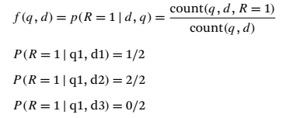

Probabilistic Retrieval Models
Clearly, p(R = 1 | d, q) + p(R = 0 | d, q) = 1

Slide 18
Unstructured Data
Can be
Text
www
Multimedia
Graph
Spatial data

Slide 20
Similarity Search in Multimedia Data
Description-based retrieval systems
Build indices and perform object retrieval based on image descriptions, such as keywords, captions, size, and time of creation
Labor-intensive if performed manually
Results are typically of poor quality if automated
Content-based retrieval systems
Support retrieval based on the image content, such as color histogram, texture, shape, objects, and wavelet transforms
texture is a repeated pattern of information or arrangement of the structure with regular intervals

Slide 21
Queries in Content-Based Retrieval Systems
Image sample-based queries
Find all of the images that are similar to the given image sample
Compare the feature vector (signature) extracted from the sample with the feature vectors of images that have already been extracted and indexed in the image database
Image feature specification queries
Specify or sketch image features like color, texture, or shape, which are translated into a feature vector
Match the feature vector with the feature vectors of the images in the database

Slide 22
Approaches Based on Image Signature
Color histogram-based signature
The signature includes color histograms based on color composition of an image regardless of its scale or orientation
No information about shape, location, or texture
Two images with similar color composition may contain very different shapes or textures, and thus could be completely unrelated in semantics
Multifeature composed signature
Define different distance functions for color, shape, location, and texture, and subsequently combine them to derive the overall result
Wavelet-based signature
Uses the dominant wavelet coefficients of an image as its signature. Wavelets capture shape, texture, and image topology information in a single unified framework

Slide 23
Automatic indexing of images
Automatic indexing of images by means of their semantics is still an open challenge
images on the Web appear in a context within textual articles or explicit image captions that provide meaningful information to the semantics of the depicted objects
Multimedia Data Mining and Analytics, Springer International Publishing Switzerland 2015

Slide 24
Multidimensional Analysis of Multimedia Data
Multimedia data cube
Design and construction similar to that of traditional data cubes from relational data
Contain additional dimensions and measures for multimedia information, such as color, texture, and shape
The database does not store images but their descriptors
Feature descriptor: a set of vectors for each visual characteristic
Color vector: contains the color histogram
MFC (Most Frequent Color) vector: five color centroids
MFO (Most Frequent Orientation) vector: five edge orientation centroids
Layout descriptor: contains a color layout vector and an edge layout vector

Slide 25



Mining Multimedia Databases
Refining or combining searches
Search for “airplane in blue sky”
(top layout grid is blue and
keyword = “airplane”)
Search for “blue sky and
green meadows”
(top layout grid is blue
and bottom is green)
Search for “blue sky”
(top layout grid is blue)

Slide 26

Mining Multimedia Databases
Three Dimensions
The Data Cube and
the Sub-Space Measurements
JPEG
GIF
Small
Medium
Large
Very Large
Two Dimensions
By Size
By Format
By Format & Size
RED
WHITE
Cross Tab
BLUE
By Colour
By Colour & Size
By Format & Colour
JPEG
GIF
RED
Sum
By Colour
WHITE
BLUE
Format of image
Duration
Colors
Textures
Keywords
Size
Width
Height
Internet domain of image
Internet domain of parent pages
Image popularity
Group By
By Format
Colour
Sum
RED
WHITE
BLUE
Dimensions
Measurement
Sum

Slide 27
Mining Associations in Multimedia Data
Three categories of Association rules can be observed involving multimedia objects in image and video databases.
Associations between image content and non-image content features: A rule like "If at least 50% of the upper part of the picture is blue, then it is likely to represent sky" belongs to this category since it links the image content to the keyword sky.
Associations among image contents that are not related to spatial relationships: A rule like "If a picture contains two blue squares, then it is likely to contain one red circle as well“
Associations among image contents related to spatial relationships: A rule like "If a red triangle is between two yellow squares, then it is likely a big oval-shaped object is underneath" belongs to this category since it associates objects in the image with spatial relationships.

Slide 28
Mining Associations in Multimedia Data
Progressive resolution refinement:
A feature may be considered as the same in two images at a certain level of resolution, but different at a finer resolution level.
How to handle it?
first mine frequently occurring patterns at a relatively rough resolution level
then focus only on those that have passed the minimum support threshold when mining at a finer resolution level
Such a multiresolution mining strategy substantially reduces the overall data mining cost without loss of the quality and completeness of data mining results

Slide 29
Mining Associations in Multimedia Data
A picture containing multiple recurrent objects is an important feature in image analysis:
For e.g., a picture containing two golden circles is treated quite differently from that containing only one. This is quite different from that in a transaction database, where the fact that a person buys one gallon of milk or two may often be treated the same as "buys_milk."
Multimedia objects have important spatial relationships such as above, beneath, between, nearby, left-of, and so on
Spatial relationships together with other content-based multimedia features, such as color, shape, texture, and keywords form interesting associations

Slide 30
What Is a Spatial Database System?
Geometric, geographic or spatial data: space-related data
Example: Geographic space (2-D abstraction of earth surface), VLSI design, model of human brain, 3-D space representing the arrangement of chains of protein molecule.
Spatial database system vs. image database systems.
Image database system: handling digital raster image (e.g., satellite sensing, computer tomography), may also contain techniques for object analysis and extraction from images and some spatial database functionality.
Spatial (geometric, geographic) database system: handling objects in space that have identity and well-defined extents, locations, and relationships.

Slide 31
GIS vs. SDBMS
GIS (Geographic Information System)
Analysis and visualization of geographic data
Common analysis functions of GIS
Search (thematic search, search by region)
Location analysis (buffer, corridor, overlay)
Terrain analysis (slope/aspect, drainage network)
Flow analysis (connectivity, shortest path)
Distribution (nearest neighbor, proximity, change detection)
Spatial analysis/statistics (pattern, centrality, similarity, topology)
Measurements (distance, perimeter, shape, adjacency, direction)
Spatial DBMS (SDBMS) is a software system that
supports spatial data models, spatial ADTs, and a query language supporting them
supports spatial indexing, spatial operations efficiently, and query optimization
can work with an underlying DBMS
Examples
Oracle Spatial Data Catridge
ESRI Spatial Data Engine

Slide 32
Modeling Spatial Objects
What needs to be represented?
Two important alternative views
Single objects: distinct entities arranged in space each of which has its own geometric description
modeling cities, forests, rivers
Spatially related collection of objects: describe space itself (about every point in space)
modeling land use, partition of a country into districts

Slide 33
Modeling Single Objects: Point, Line and Region
Point: location only but not extent
Line (or a curve usually represented by a polyline, a sequence of line segment):
moving through space, or connections in space (roads, rivers, cables, etc.)
Region:
Something having extent in 2D-space (country, lake, park). It may have a hole or consist of several disjoint pieces.

Slide 34
Modeling Spatially Related Collection of Objects
Modeling spatially related collection of objects: plane partitions and networks.
A partition: a set of region objects that are required to be disjoint (e.g., a thematic map). There exist often pairs of objects with a common boundary (adjacency relationship).
A network: a graph embedded into the plane, consisting of a set of point objects, forming its nodes, and a set of line objects describing the geometry of the edges, e.g., highways. rivers, power supply lines.
Other interested spatially related collection of objects: nested partitions, or a digital terrain (elevation) model.

Slide 35
Spatial Data Types and Models
Field-based model: raster data
framework: partitioning of space
Object-based model: vector model
point, line, polygon, Objects, Attributes

Slide 36
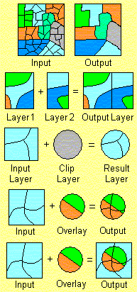
Spatial-to-Spatial Generalization
Generalize detailed geographic points into clustered regions, such as businesses, residential, industrial, or agricultural areas, according to land usage
Requires the merging of a set of geographic areas by spatial operations
Dissolve
Merge
Clip
Intersect
Union

Slide 37
Spatial Association Analysis
Spatial association rule: A ⇒ B [s%, c%]
A and B are sets of spatial or non-spatial predicates
Topological relations: intersects, overlaps, disjoint, etc.
Spatial orientations: left_of, west_of, under, etc.
Distance information: close_to, within_distance, etc.
s% is the support and c% is the confidence of the rule
Examples
1) is_a(x, large_town) ^ intersect(x, highway) → adjacent_to(x, water)
[7%, 85%]
2) What kinds of objects are typically located close to golf courses?

Slide 38
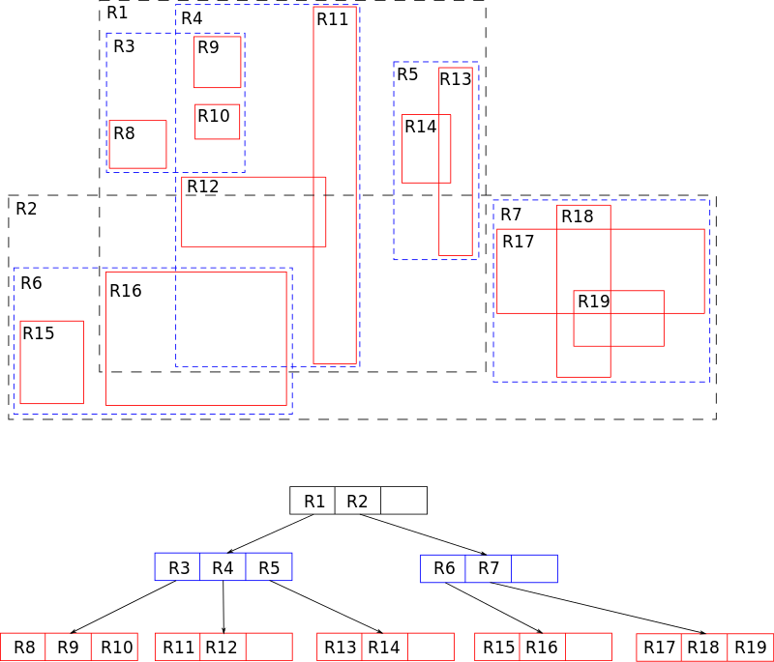
Progressive Refinement Mining of Spatial Association Rules
Hierarchy of spatial relationship:
g_close_to: near_by, touch, intersect, contain, etc.
First search for rough relationship and then refine it
Two-step mining of spatial association:
Step 1: Rough spatial computation (as a filter)
Using MBR (Minimum bounding rectangle) or R-tree for rough estimation
Step2: Detailed spatial algorithm (as refinement)
Apply only to those objects which have passed the rough spatial association test (no less than min_support)
"R-tree" by Skinkie, w:en:Radim Baca - Own work. Licensed under Public Domain via Commons - https://commons.wikimedia.org/wiki/File:R-tree.svg#/media/File:R-tree.svg

Slide 39
Mining Spatial Co-location Rules
Co-location rule is similar to association rule but explore more relying spatial auto-correlation
It can be integrated with progressive refinement to further improve its performance
Spatial co-location mining idea can be applied to clustering, classification, outlier analysis and other potential mining tasks
Spatial data tends to be highly self-correlated
Example: Neighborhood, Temperature
Items in a traditional data are independent of each other, whereas properties of locations in a map are often “auto-correlated”.
First law of geography:
“Everything is related to everything, but nearby things are more related than distant things.” weight of the vehicle increase… milage will decrease
GIS… lake full….. Crops… water level… increase…. autocorrelation

Slide 40
Spatial Classification
Methods in classification
Decision-tree classification, Naïve-Bayesian classifier + boosting, neural network, logistic regression, etc.
Association-based multi-dimensional classification - Example: classifying house value based on proximity to lakes, highways, mountains, etc.
Assuming learning samples are independent of each other
Spatial auto-correlation violates this assumption!

Slide 41
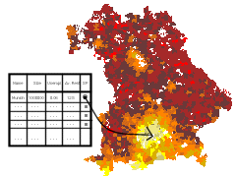
Spatial Trend Analysis
Function
Detect changes and trends along a spatial dimension
Study the trend of non-spatial or spatial data changing with space
Application examples
Observe the trend of changes of the climate or vegetation with increasing distance from an ocean
Crime rate or unemployment rate change with regard to city geo-distribution

Slide 42
Generalizing Spatial and Multimedia Data
Spatial data:
Generalize detailed geographic points into clustered regions, such as business, residential, industrial, or agricultural areas, according to land usage
Require the merge of a set of geographic areas by spatial operations
Image data:
Extracted by aggregation and/or approximation
Size, color, shape, texture, orientation, and relative positions and structures of the contained objects or regions in the image
Music data:
Summarize its melody: based on the approximate patterns that repeatedly occur in the segment
Summarized its style: based on its tone, tempo, or the major musical instruments played

Slide 43
Constraints-Based Clustering
Constraints on individual objects
Simple selection of relevant objects before clustering
Clustering parameters as constraints
K-means, density-based: radius, min-# of points
Constraints specified on clusters using SQL aggregates
Sum of the profits in each cluster > $1 million
Constraints imposed by physical obstacles
Clustering with obstructed distance

Slide 44
Constrained Clustering: Planning ATM Locations
C3
C2
Bridge
C1
River
Mountain
C4
Spatial data with obstacles
Clustering without taking
obstacles into consideration

Slide 45
Why Graph Mining?
Graphs are ubiquitous
Chemical compounds (Cheminformatics)
Protein structures, biological pathways/networks (Bioinformactics)
Program control flow, traffic flow, and workflow analysis
XML databases, Web, and social network analysis
Graph is a general model
Trees, lattices, sequences, and items are degenerated graphs
Diversity of graphs
Directed vs. undirected, labeled vs. unlabeled (edges & vertices), weighted, with angles & geometry (topological vs. 2-D/3-D)
Complexity of algorithms: many problems are of high complexity

Slide 46
Information on a Network
Heterogeneous, multi-relational data represented as a graph or network
Nodes are objects
May have different kinds of objects
Objects have attributes
Objects may have labels or classes
Edges are links
May have different kinds of links
Links may have attributes
Links may be directed, are not required to be binary
Links represent relationships and interactions between objects - rich content for mining

Slide 47
Graph Pattern Mining
Frequent subgraphs
A (sub)graph is frequent if its support (occurrence frequency) in a given dataset is no less than a minimum support threshold
Applications of graph pattern mining
Mining biochemical structures
Program control flow analysis
Mining XML structures or Web communities
Building blocks for graph classification, clustering, compression, comparison, and correlation analysis

Slide 48
Example: Frequent Subgraphs
GRAPH DATASET
(A)
(B)
(C)
FREQUENT PATTERNS
(MIN SUPPORT IS 2)
(1)
(2)

Slide 49
AprioriGraph: Apriori-based frequent substructure mining.
Input: D, a graph data set;
min_sup, the minimum support threshold.
Output: S_{k}, the frequent substructure set.
Method:
S₁ ← frequent single-elements in the data set;
Call AprioriGraph(D, min_sup, S₁);
procedure AprioriGraph(D, min_sup, S_{k})
(1) S_{k+1} ← ∅;
(2) for each frequent g_{i} ∈ S_{k} do
(3) for each frequent g_{j} ∈ S_{k} do
(4) for each size (k + 1) graph g formed by the merge of g_{i} and g_{j} do
(5) if g is frequent in D and g ∉ S_{k+1} then
(6) insert g into S_{k+1};
(7) if s_{k+1} ≠ ∅ then
(8) AprioriGraph(D, min_sup, S_{k+1});
(9) return;

Slide 50
Properties of Graph Mining Algorithms
Search order
breadth vs. depth
Generation of candidate subgraphs
apriori vs. pattern growth
Elimination of duplicate subgraphs
passive vs. active
Discover order of patterns
path → tree → graph

Slide 51
Apriori-Based Approach
(k+1)-edge
k-edge
G₁
G
G₂
G’
…
G’’
G_{n}
JOIN

Slide 52
Apriori-Based, Breadth-First Search
Methodology: breadth-search, joining two graphs
AGM (Inokuchi, et al. PKDD’00)
generates new candidate graphs with one more node
FSG (Kuramochi and Karypis ICDM’01)
generates new candidate graphs with one more edge

Slide 53
Pattern Growth Method
(k+2)-edge
(k+1)-edge
G₁
…
k-edge
G₂
duplicate
graph
G
…
G_{n}
…
Notes:
Apriori:
Step1: Join two k-1 edge graphs (these two graphs share a same k-2 edge subgraph) to generate a k-edge graph
Step2: Join the tid-list of these two k-1 edge graphs, then see whether its count is larger than the minimum support
Step3: Check all k-1 subgraph of this k-edge graph to see whether all of them are frequent
Step4: After G successfully pass Step1-3, do support computation of G in the graph dataset, See whether it is really frequent.
gSpan:
Step1: Right-most extend a k-1 edge graph to several k edge graphs.
Step2: Enumerate the occurrence of this k-1 edge graph in the graph dataset, meanwhile, counting these k edge graphs.
Step3: Output those k edge graphs whose support is larger than the minimum support.
Pros:
1: gSpan avoid the costly candidate generation and testing some infrequent subgraphs.
2: No complicated graph operations, like joining two graphs and calculating its k-1 subgraphs.
3. gSpan is very simple
The key is how to do right most extension efficiently in graph. We invented DFS code for graph.

Slide 54
Graph Pattern Explosion Problem
If a graph is frequent, all of its subgraphs are frequent ─ the Apriori property
An n-edge frequent graph may have 2^{n} subgraphs
Among 422 chemical compounds which are confirmed to be active in an AIDS antiviral screen dataset, there are 1,000,000 frequent graph patterns if the minimum support is 5%

Slide 55
Closed Frequent Graphs
Motivation: Handling graph pattern explosion problem
Closed frequent graph
A frequent graph G is closed if there exists no supergraph of G that carries the same support as G
If some of G’s subgraphs have the same support, it is unnecessary to output these subgraphs (nonclosed graphs)
Lossless compression: still ensures that the mining result is complete

Slide 56
Graph Clustering
Graph similarity measure
Feature-based similarity measure
Each graph is represented as a feature vector
The similarity is defined by the distance of their corresponding vectors
Frequent subgraphs can be used as features
Structure-based similarity measure
Maximal common subgraph
Graph edit distance: insertion, deletion, and relabel
Graph alignment distance

Slide 57
Graph Classification
Local structure based approach
Local structures in a graph, e.g., neighbors surrounding a vertex, paths with fixed length
Graph pattern-based approach
Subgraph patterns from domain knowledge
Subgraph patterns from data mining

Slide 58
Graph Pattern-Based Classification
Subgraph patterns from domain knowledge
Molecular descriptors
Subgraph patterns from data mining
General idea
Each graph is represented as a feature vector x = {x₁, x₂, …, x_{n}}, where x_{i} is the frequency of the i-th pattern in that graph
Each vector is associated with a class label
Classify these vectors in a vector space

Slide 59
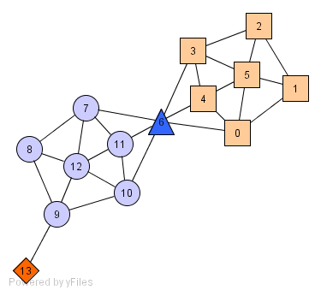
A Social Network Model
Individuals in a tight social group, or clique, know many of the same people
regardless of the size of the group
Individuals who are hubs know many people in different groups but belong to no single group
leaders bridge multiple groups
Individuals who are outliers reside at the margins of society
know few people and belong to no group

Slide 60
The Neighborhood of a Vertex
Define Γ(ν) as the immediate neighborhood of a vertex
i.e. the set of people that an individual knows

Slide 61
Structure Similarity
The desired features tend to be captured by a measure called Structural Similarity
Define Γ(ν) as the immediate neighborhood of a vertex (i.e. the set of people that an individual knows )
Structural similarity is large for members of a clique and small for hubs and outliers.

Slide 62
Link Mining
Link: relationship among data
Two kinds of linked networks
homogeneous vs. heterogeneous
Homogeneous networks
Single object type and single link type
Single model social networks (e.g., friends)
WWW: a collection of linked Web pages
Heterogeneous networks
Multiple object and link types
Medical network: patients, doctors, disease, contacts, treatments
Bibliographic network: publications, authors, venues

Slide 63
Link-Based Object Ranking (LBR)
LBR: Exploit the link structure of a graph to order or prioritize the set of objects within the graph
Focused on graphs with single object type and single link type
This is a primary focus of link analysis community
Web information analysis
PageRank and Hits are typical LBR approaches
In social network analysis (SNA), LBR is a core analysis task
Objective: rank individuals in terms of “centrality”
Rank objects relative to one or more relevant objects in the graph vs. ranks object over time in dynamic graphs

Slide 64
Graph Mining Challenges
High computational cost
Need to tradeoff between efficiency/scalability and quality
Sophisticated graphs
May involve weights and/or cycles.
High dimensionality
A graph can have many vertices. In a similarity matrix, a vertex is represented as a vector (a row in the matrix) whose dimensionality is the number of vertices in the graph
Sparsity
A large graph is often sparse, meaning each vertex on average connects to only a small number of other vertices
A similarity matrix from a large sparse graph can also be sparse
64

